Slide 1


CHANGE DETECTION OVER MULTI-SPECTRAL IMAGES USING MACHINE LEARNING TECHNIQUES
Department of Information Technology
V R Siddhartha Engineering College
AI – ML Applications Research Group
B.Tech in Information Technology
MINI Project Review Presentation
Presented by
P SURYA PRAKASH(198W1A1249)
CH P V N KUMAR (208W5A1201)
SK FYZULLA (208W5A1206)
Under the guidance of
Dr. CS PAVAN KUMAR.,
ASST. Professor , IT Dept.

Slide 2
PROBLEM STATEMENT
The main idea is to apply change detection in order to identify changes
among the region in different timelines to find land use, land cover and
change in urbanization.
To perform Classification and Change Detection on a particular area using
Landsat-8 Satellite Images, Machine Learning & GIS Tools.
Specifically, to identify the change in LAND COVER use class for the district
VIZAG, India.

Slide 3
OBJECTIVES AND OUTCOMES
To know more about land classification and land use of particular areas.
Providing a base map for graphical reference and assisting planners and engineers.
Extracting mineral deposits with remote sensing based spectral analysis.
Disaster mitigation planning and recovery.
Agriculture Development.
3D Geographic Information System.

Slide 4
LITERATURE REVIEW
PAPER | AUTHORS AND SOURCE | ALGORITHM | RESULTS | REMARKS
A comparison of pixel and object-based change detection techniques using Landsat-8 multispectral imagery from Barrancabermeja city | Henry J. Areiza-Laverde and Maria C. Torres-Madronero.2018 IEEE 2nd CCRA | Maximum Likelihood Classifier Bhattacharyya Classifier | This paper ends up proving that the object-based classification give better results for change detection than pixel-based techniques. | Although pixel-based classification is traditional it does confuse for simple soil, water classification. Therefore, a much more promising object-based technique is needed.
Change Detection Techniques Based on Multispectral Images for Investigating Land Cover Dynamics | Dyah R. Panuju, David J. Paull and Amy L. Griffin. MDPI, 2020 | PCA Fourier Transform Wavelet Transform Ensemble Empirical Mode Decomposition Seasonal trend analysis | This article reviews advances in bitemporal and multitemporal two dimensional Change Detection (CD) with a focus on multispectral images. | Change detection is an important field of study. Beyond 2D change detection, advances should be made in 3D change detection and more.

Slide 5
LITERATURE REVIEW
PAPER | AUTHORS AND SOURCE | ALGORITHM | RESULTS | REMARKS
Performance Analysis of Change Detection Algorithms on 20 Multispectral Imagery | Indira Bidari; Satyadhyan Chickerur; Rekha.M. Talikoti. IEEE, 2020. | PCA PCA-K means Multivariate Alteration Detection Iteratively Reweighted MAD. | Results show that these methods proposed in multispectral images perform better. PCA with K-means has taken less execution time among four. | Only one algorithm is not suitable for every case of change detection. Various algorithms perform in various ways at times
Deep Learning for Change Detection in Remote Sensing Images | MAX MIGNOTTE LAZHAR KHELIFI | DBN CNN RNN GAN | The performance of various algorithms compared | CD can be done using Deep Reinforcement learning Weekly supervised change detection

Slide 6
LITERATURE REVIEW
PAPER | AUTHORS AND SOURCE | ALGORITHM | RESULTS | REMARKS
Change Detection using Deep Learning and Machine Learning techniques for Multi-spectral satellite Images | T.VIGNESH K.K. THYAGHARAJAN K,RAMYA | CNN | Analysed the ML and DL Techniques performance | Analysis only on whether
Deep Learning for Change Detection in Remote Sensing Images | MAX MIGNOTTE LAZHAR KHELIFI | DBN CNN RNN GAN | The performance of various algorithms compared | CD can be done using Deep Reinforcement learning Weekly supervised change detection

Slide 7
DATASET AND REQUIREMENTS
MULTI SPECTRAL SATELLITE IMAGES
MACHINE LEARNING ALGORITHMS
JUPYTER NOTEBOOK
QGIS TOOL
USGS EARTH EXPLORER

Slide 8
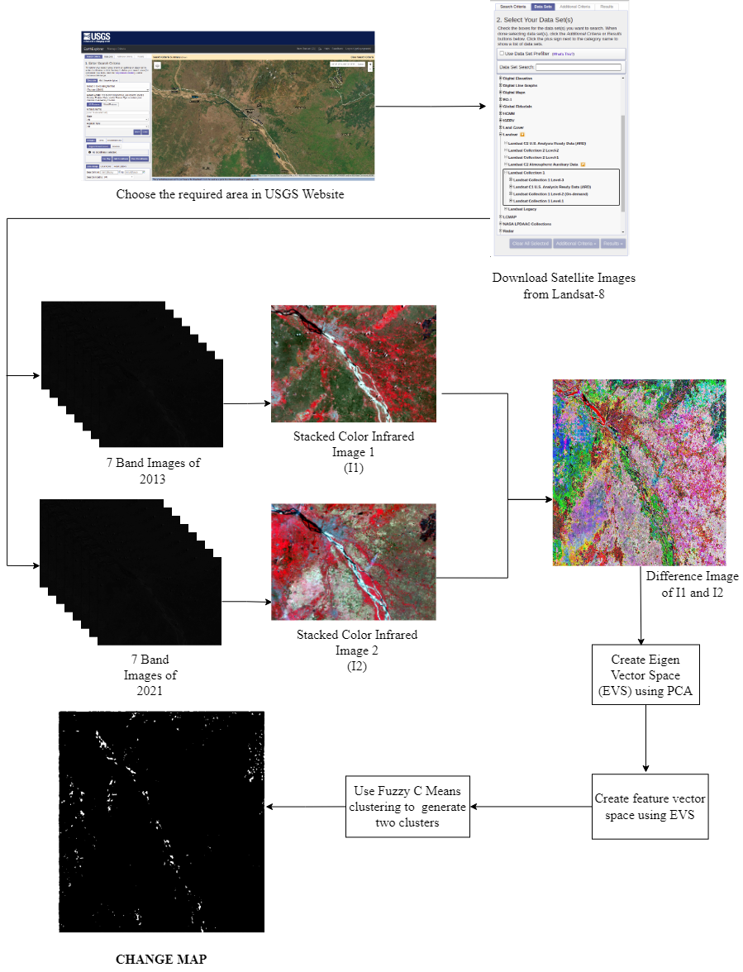
ARCHITECTURE

Slide 9
PROJECT FLOW
Getting the dataset.
Representing data into a structure.
Standardizing the data.
Calculating the Covariance of Z.
Calculating the Eigen Values and Eigen Vectors.
Sorting the Eigen Vectors.
Calculating the new feature vector space using eigenvector space.
Generate two clusters using FUZZY C-MEANS clustering.
Assign each feature vector to the nearest cluster using Euclidean distance to get the output.

Slide 10
THANK YOU

